Slide 1



Stock market
Information Visualization

Slide 2


Team members:
Ismaeel Muhammad
Akram Mahmoud
Ahmed Serag
Omar Hosny
Abdel-Rahman Reda
20201700125
20201700128
20201700045
20201700533
20201700474

Slide 3
Dataset description:
The data set is historical data for stock market, Our data set is combined from multiple sources, the main attribute is the symbol attribute which refers to a specific stock

Slide 4
Data pre-processing
Converting the Date into Date data type instead of String
Trimming the rows that falls in a date Gap (too much nulls before 2002)
Dropping null columns
Filling null values with smoothing methods (down up)
**can’t use a statistical parameter as it is a time series data set, ex. The mean wouldn’t be logically or visually applicable
Trimming data to optimizing computational time
Drop nulls from the final Data frame

Slide 5
Graphical User Interface (GUI)
Dashboard components:
Sidebar for filtering the visualizations’ output.
Tabs to switch between different visualizations.
Visualizations:
Line chart.
Boxplot.
Candlesticks chart (for Time series visualizations).
Scatterplot.
Histogram.
Area chart.
Bar chart.

Slide 6
Visualizations
Line chart:
A relation between VWAP (Volume Weighted Average Price) on Y axis and Date on X axis.
Boxplot:
A relation between Volume on Y axis and Date on X axis.
Candlesticks chart:
A relation between Open, High, low, close on Y axis and Date on X axis.
It is specified for TSA in Stock market that’s why it takes 4 Y’s to easily infer the domain related information.

Slide 7
Visualizations Cont
Scatter plot:
A relation between Turnover on Y axis and Date on X axis.
Histogram:
A relation between Deliverable Volume on Y axis and Its frequency on X axis.
Area chart:
A relation between %Deliverable on Y axis and Date on X axis.
(%Deliverable: The percentage of deliverable volume to total volume.)
Bar chart:
A relation between Industry on Y axis and Its frequency on X axis.

Slide 8
Observations

Slide 9
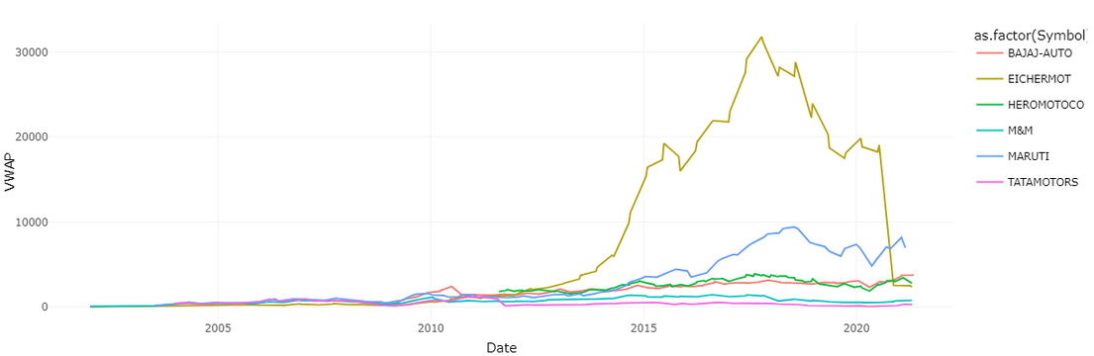
Line Chart
the Automobile indusrty stock “EIGHERMOT” scored its highest VWAP at 10/10/2017 which was 31815.44

Slide 10
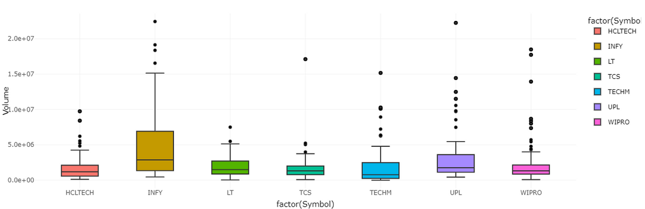
Boxplot
notice the closeness of the mean value of the Volume at the IT, Construction,
Fertilisers & Pesticides Industries Stockes.

Slide 11
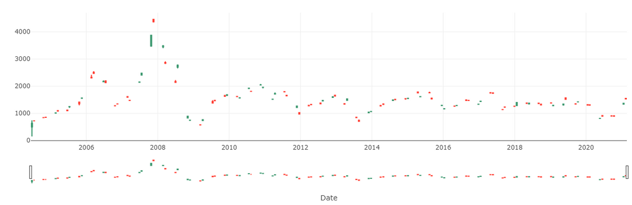
Candlestick Chart
In the Construction Indusrty we have only one Stock called LT which stands for Larsen & Toubro Ltd.
it was at its best at OCT 2007
with the values:
open 3480, high 3895, low 3450, close3872.8

Slide 12
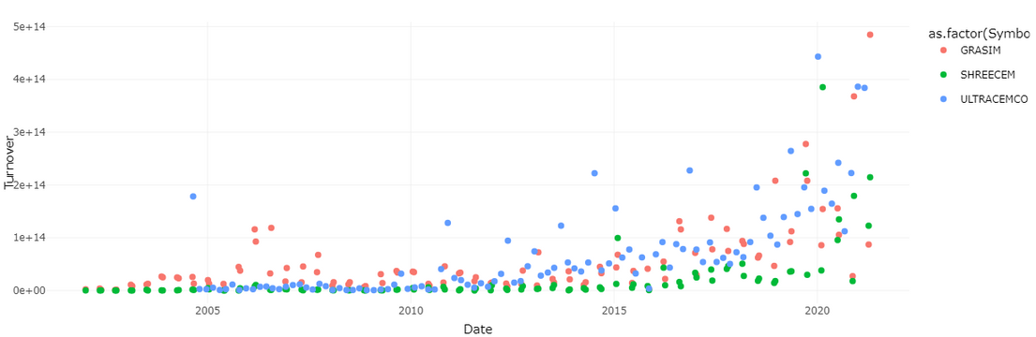
Scatter plot
in the Cement & Cement products industry it is obvious that the values of the turnover are highly correlated
but the figure shows that all the stocks of this industry had a great rise around 2020

Slide 13
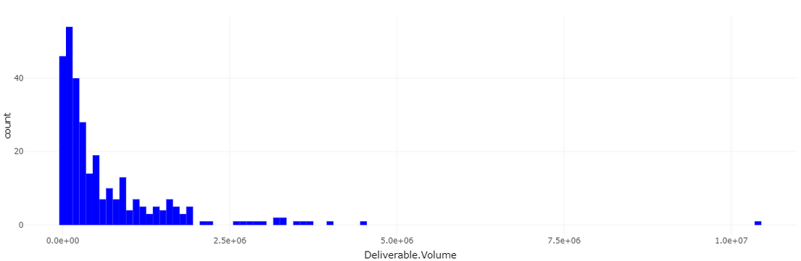
Histogram
The general shape of distribution of the value of the Deliverble Volume is Right Skewed
the shown distribution is for the Phrama industry Stocks

Slide 14
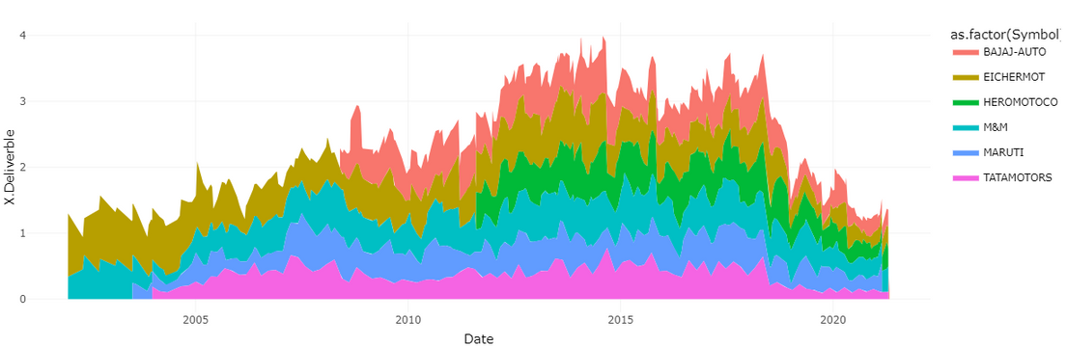
Area Chart
The shown Area chart shows the values of %Deliverables of the Automobile industry
the highest values is the stock BAJAJ-AUTO and it refers to Bajaj Auto Ltd.

Slide 15
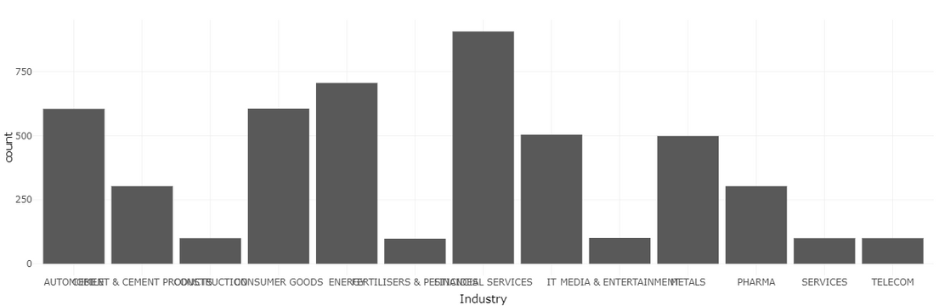
Bar Chart
And this is a count of the number of the Stocks coverd in this dataset
in every Industry,
we can’t take this number as we took only a subset of thedataset to reduce computational power & time
but the most stocks in this dataset are in the FINANCIAL SERVICES industries

Slide 16
Thank you

